Slide 1

Emotion based emoji suggestion
Lujain Alghamdi

Slide 2
AGENDA
Introduction​
Project plan
​Datasets
Model results
Demo
​​

Slide 3
Introduction
Usually chat services suggest emojis based on the literal meaning of the last word in a text message instead of taking the whole message into account, an alternative and better way is to have it suggest an emoji based on the emotion of the full text or conversation.
Some phrases are easy to translate into emojis, while some require understanding of the emotion behind that phrase. The emotions considered in this project are:
joy😃 fear😱 sadness😢 anger😡 surprise😯 love🥰

Slide 4
The main question is: can we make emoji suggestion better?

Slide 5
Project plan
datasets
Merge into one
Transfer learning
Random forest
App
Find datasets that can give me information about emojis, text and emotions
Merge the different datasets to show relationships and find meaning
Perform transformer-based implementation of Google's T5 base fine-tuned for Emotion Recognition
Train a Random Forest model and test the results
Deploy the model on a Stream lit app

Slide 6



Different datasets used
Tweets
Size: 1,320,035 (only 49 unique emojis)
Emojis
Size: 969 Obs.
Emotions
Size: 16,000 obs.
Text | Unicode name
Thats me in every lesson | FACE WITH TEARS OF JOY
Partner strategy LLRC Urban naxal theories | FACE WITH TEARS OF JOY
Happy Birthday More blessings Matsatsi | CLAPPING HANDS
There are MANY of you 🇺 🇸 🇺 🇸 🇮 🇱 | THUMBS UP
Emoji | Unicode name
😂 | FACE WITH TEARS OF JOY
❤ | HEAVY BLACK HEART
😍 | SMILING FACE WITH HEART-SHAPED EYES
😭 | LOUDLY CRYING FACE
Text | Label
i didnt feel humiliated | sadness
i can go from feeling so hopeless to so damned… | Sadness
i am ever feeling nostalgic about the fireplac… | love
i am feeling grouchy | anger

Slide 7
Step 1
Tweets
Size: 1,320,035 (only 49 unique emojis)
Emojis
Size: 969 Obs.
Tweet – emojis
Size: 741,777 (25 unique emojis)
Text | Unicode name
Thats me in every lesson | FACE WITH TEARS OF JOY
Partner strategy LLRC Urban naxal theories | FACE WITH TEARS OF JOY
Happy Birthday More blessings Matsatsi | CLAPPING HANDS
There are MANY of you 🇺 🇸 🇺 🇸 🇮 🇱 | THUMBS UP
Emoji | Unicode name
😂 | FACE WITH TEARS OF JOY
❤ | HEAVY BLACK HEART
😍 | SMILING FACE WITH HEART-SHAPED EYES
😭 | LOUDLY CRYING FACE
Text | Emoji
Thats me in every lesson | 😂
Partner strategy LLRC Urban naxal theories | 😂
Happy Birthday More blessings Matsatsi | 👏
There are MANY of you 🇺 🇸 🇺 🇸 🇮 🇱 | 👍

Slide 8
Step 2
Tweet – Emojis
Size: 741,777 (25 unique emojis)
Emotions
Size: 16,000 obs.
Final dataset
Size: 383,976
Transfer learning
Text | Emotion | Emoji
Thats me in every lesson | Joy | 😂
Partner strategy LLRC Urban naxal theories | Joy | 😂
Happy Birthday More blessings Matsatsi | Love | 👏
There are MANY of you 🇺 🇸 🇺 🇸 🇮 🇱 | Anger | 👍
Text | Emotion
i didnt feel humiliated | Sadness
i can go from feeling so hopeless to so damned… | Sadness
i am ever feeling nostalgic about the fireplac… | Love
i am feeling grouchy | Anger
Text | Emotion | Emoji
i have been with petronas for years | Joy | 😂
i am feeling grouchy | Anger | 💀
i am feeling nostalgic about the fireplac... | Love | 😍
i didnt feel humiliated | Sadness | 😭

Slide 9
Final dataset
Size: 383,976 obs.
25 Unique emojis
6 unique emotions
Text | Emotion | Emoji
i have been with petronas for years | Joy | 😂
i am feeling grouchy | Anger | 💀
i am feeling nostalgic about the fireplac... | Love | 😍
i didnt feel humiliated | Sadness | 😭

Slide 10
Challenges
Not finding a labelled text – emoji dataset with accurate names
Merging the datasets created a very large dataset that was sometimes difficult to deal with
Getting the emotion of emojis using transformers was time consuming
Choosing a good classification algorithm for NLP

Slide 11
Emojis associated with emotions
Sadness | Anger | Love | Joy | Surprise | Fear
💀 | 😩 | 💙 | 💙 | 😊 | ✨
😢 | ✅ | 😳 | ✔ | 💛 | 😩
😩 | 😉 | 😊 | 🎉 | 😭 | 😊
💜 | 😳 | ✨ | 🏆 | 👀 | 💪

Slide 12
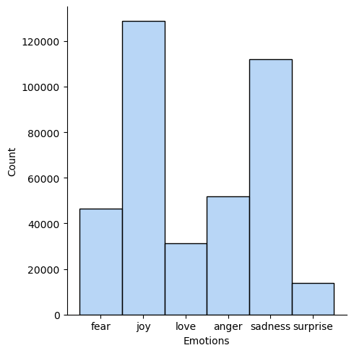
Emotions distribution

Slide 13
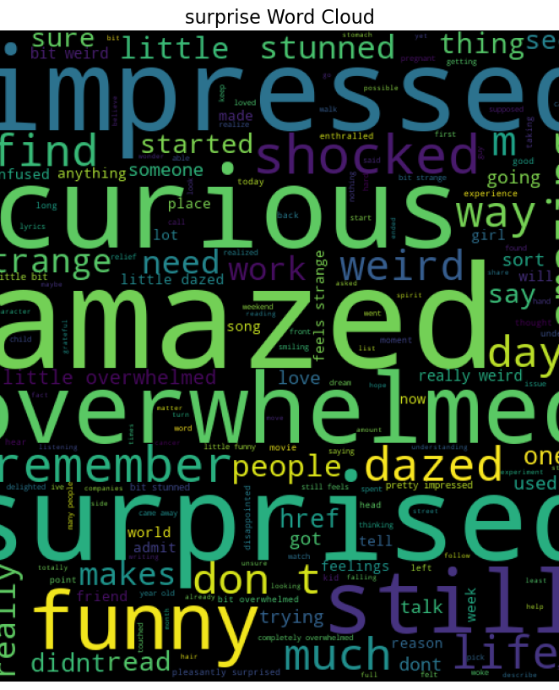
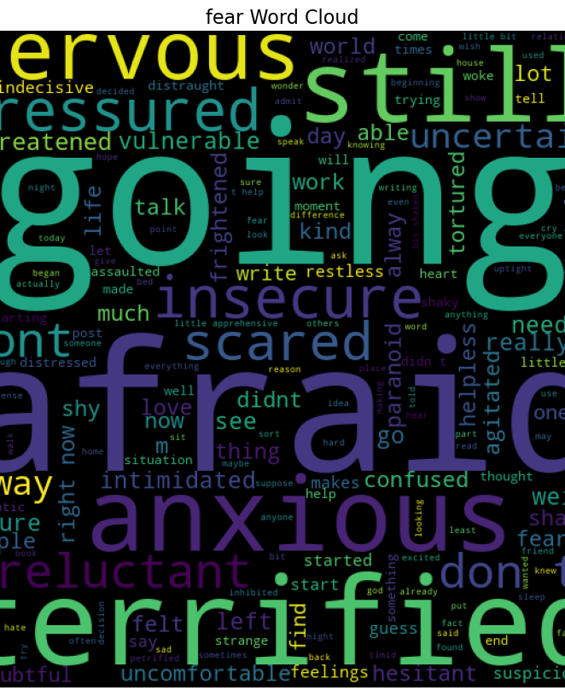
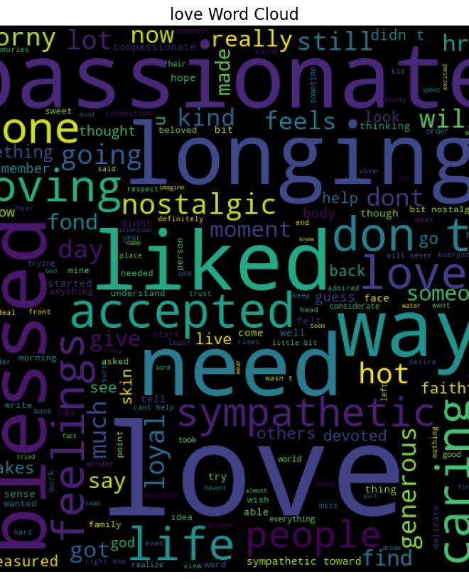
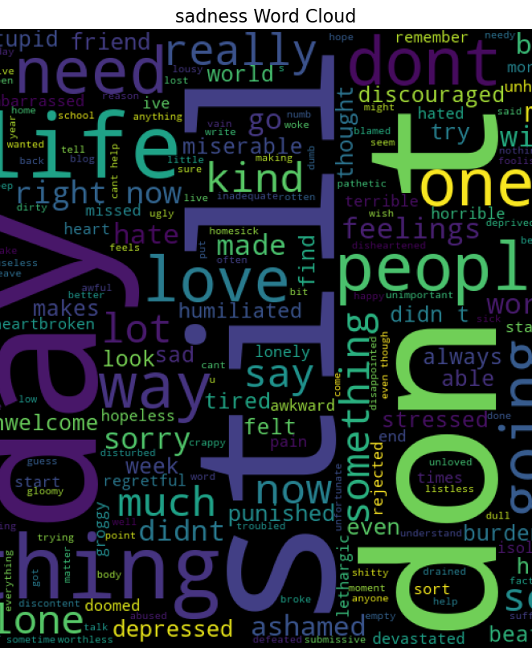
Emotion word cloud
Surprise
Fear
Love
Sadness

Slide 14
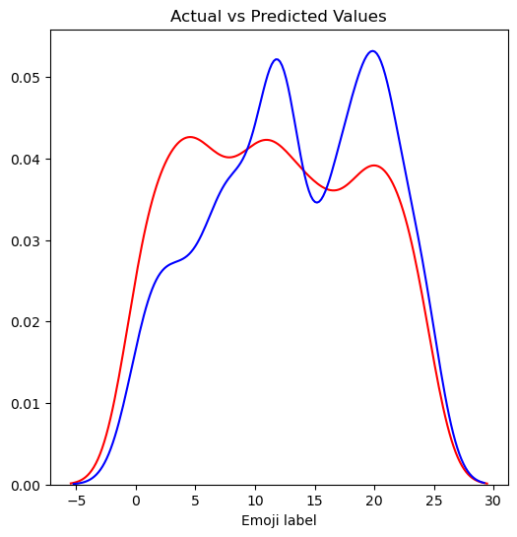
classifier
Variation in emoji distribution
Random forest
Number of estimators: 400
Predictive accuracy tends to increase with the increase of the number of trees
Accuracy: 1016.73005
After further investigation of the plot, the two emojis with the greatest number of observations are:
'💙’: label 12 (n = 161)
'😂’: label 17 (n = 88)

Slide 15
App Demo
-

Slide 16
Future development
Add the ability to process a full conversation
Use a larger and more comprehensive (text – emotion – emoji) dataset to add to the 25 emojis
Train a deep learning model and compare results

Slide 17
References
Dataset 1:
https://www.kaggle.com/datasets/rexhaif/emojifydata-en?select=emojitweets-01-04-2018.txt
Dataset 2:
https://www.clarin.si/repository/xmlui/handle/11356/1048
Dataset 3:
https://www.kaggle.com/datasets/praveengovi/emotions-dataset-for-nlp?resource=download&select=train.txt

Slide 18
THANK YOU for listening
Special thanks to Dr. Rick and Lujain
Lujain Alghamdi
https://github.com/Jainlo/context-based-emoji-suggestion

